Slide 1
Group 2 TRIHUB CLUB Sprint 4
Aaron Lewis, Stephen agbenu, young kim, matthew Rinaldo, Mohamed bouh

Slide 2
What is the Product
Our product allows for educators to utilize a tool that enables them to monitor student responsiveness during class and uses the information obtained to provide a productive and responsive class lecture experience.

Slide 3
What is the value
The value of our product is to provide a service for educators that allows them to efficiently structure class lectures in order to maximize student attentiveness and not bore you with your typical mundane lecture

Slide 4
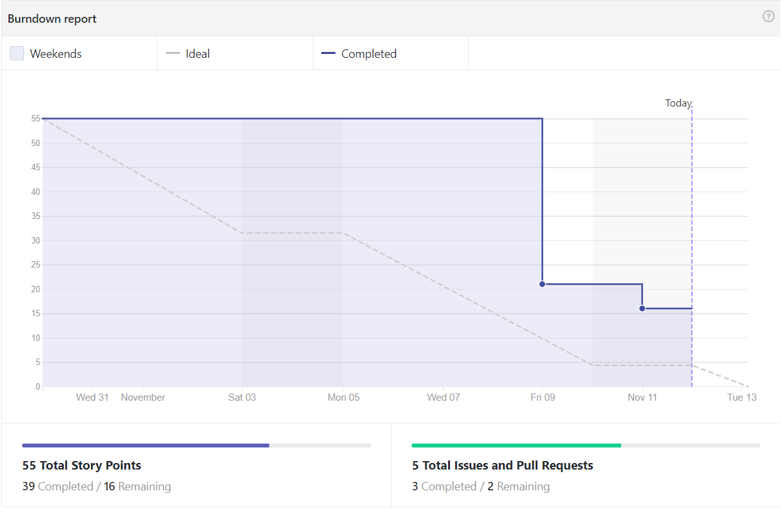
Sprint 4 Burndown chart

Slide 5
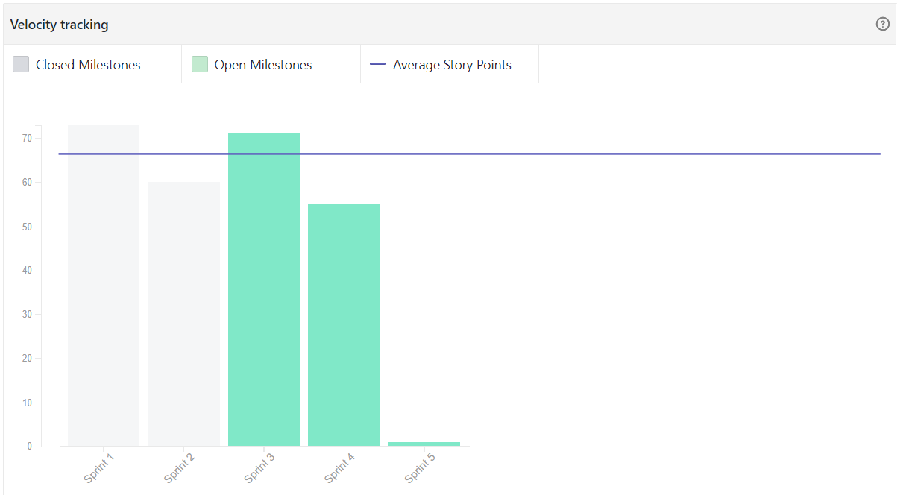
Velocity chart

Slide 6
Completed Stories for Sprint 4 overview
Implement refresh button functionality
Implement determineScheduledUsers method
Change checkboxes to assist with getting Boolean values
Write schedules to the database
Figure out how time scheduling works

Slide 7
Implement refresh button functionality
User Story This method is vital because refresh allows the user to stop seeing the users that are already scheduled. This is important because the administrator only needs to see the users that are currently not scheduled, so the refresh button will make a call to the database to see all users, and will choose only the users who have not passed their scheduled time plus 10 minutes

Slide 8
Implement determineScheduledUsers method
Method should loop through list of users being displayed
Clear out scheduledUsers variable
Add user Id of every user that has a check mark
This relied on completing the restructuring of the checkbox’s on the main table

Slide 9
Change checkboxes to assist with getting Boolean values
In order to assist with the ability to get the boolean value of Person objects, As a Programmer I want to find a way to dynamically determine whether a checkbox is clicked or not.
This was actually a somewhat difficult problem to solve, because we had to change the way the Person class was laid out in order to make the checkboxes dynamically change and return Boolean values.

Slide 10
Write schedules to the database
Need to write schedules to the database given a schedule object and a list of person objects, that will allow the application to communicate with the backend and pass them a list of user ID’s to be scheduled for responses.

Slide 11
Figure out how time scheduling works
Needed to communicate with the backend team to answer a few key questions such as:
Figure out when each user will be sent text messages
How long does each user have to send text message with emoji back?

Slide 12
Backlog
Implement a time selector to facilitate datetime selection
Clear out the selected users array so the each time the submit button is pressed it doesn’t rewrite users

Slide 13
Test Scenario 1
A Georgia State professor notices during his lectures the attentiveness of students isn’t always up to par with his expectations. The professor wants to restructure his lectures in a way where students are attentive throughout the whole lecture. The professor utilizes the emoji app to get the random responses of how students are feeling during class. Once the professor obtains these responses, he uses them to restructure his lectures to fit the students needs.

Slide 14
Test cases for scenario 1
Does the app account for unresponsive users?
Does the group of scheduled users clear once submitted?
Does the app allow the admin to select different times for different users?
Does the table retain users if HTTP Post connection fails?
Does the app display what time interval where users are least attentive?

Slide 15
Test scenario 2
A project manager is working on developing a software and wants to track the teams morale throughout the course of the project. The project manager wants to obtain this information in order to structure the sprints to fit the needs of the group.

Slide 16
Test case for scenario 2
Does the app show every member of the team?
Does the app allow the administrator to view changes when new users have been scheduled?
Does the user actually receive a message at the scheduled time?
Does the user become active in the list 10 minutes after their scheduled time?
Does the exported csv file have the correct format?

